Slide 1


BASRAH UNIVERSITY
Faculty of Education for Pure Sciences
Biology Department
2025- 2026
Lecture 3
Kingdom Protista
Presented By: Prof. Dr. Sabeeh H. AL-Mayah

Slide 2
Class Zoomastigophorea
Members lack chloroplasts and are heterotrophic.
Some members are important parasites of humans.
Trypanosoma brucei is a zoomastigophorean which is an important pathogen of human beings that cause sleeping sickness.
This species is divided into three subspecies: T. b. brucei, T.b. gambiense, and T.b. rhodesiense, often referred to as the Trypanosoma brucei complex.

Slide 3
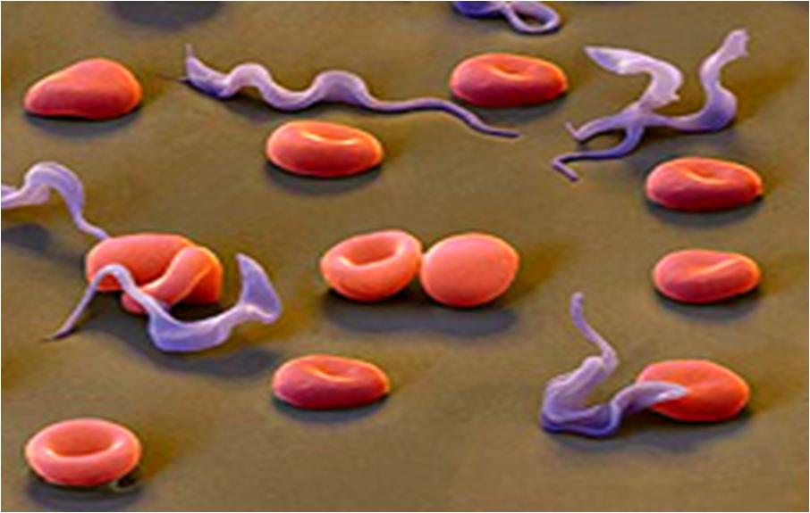
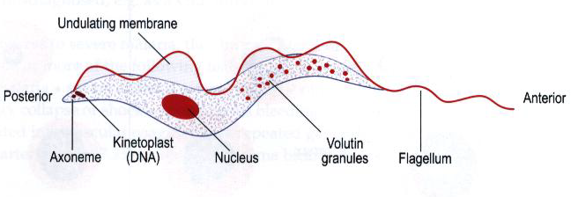
Trypanosomes
Trypanosomes are flagellated protozoa,
trypomastigote in shape, with elongated body,
central nucleus,
posterior kinetoplast,
long undulating membrane
and anterior free flagellum.

Slide 4
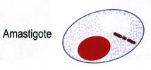
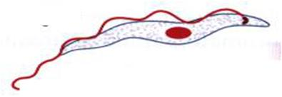
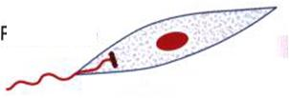
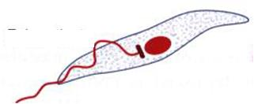
There are 4 parasitic stages (or forms):
Amastigote & Trypomastigote occur in vertebrate hosts
Promastigote & Epimastigote occur in invertebrate hosts
Amastigote
Trypomastigote
Promastigote
Epimastigote

Slide 5
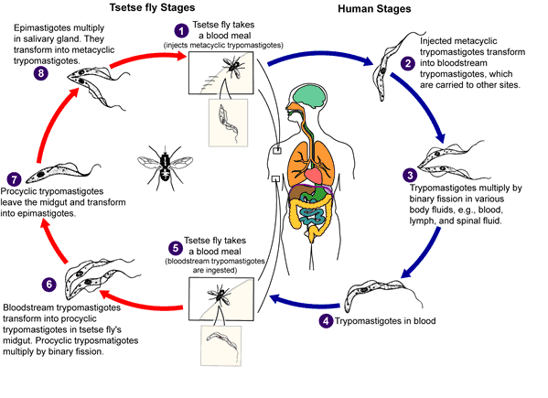

Slide 6
1. During a blood meal on the mammalian host, an infected tsetse fly injects metacyclic trypomastigotes
into skin tissue. The parasites enter the lymphatic system and pass into the bloodstream
2. Inside the host, they transform into bloodstream trypomastigotes
Trypomastigotes are carried to other sites throughout the body, reach other blood fluids (e.g., lymph, spinal fluid), and
continue the replication by binary fission
4. The tsetse fly becomes infected with bloodstream trypomastigotes when taking a blood meal on an infected mammalian host
5.In the fly’s midgut, the parasites transform into procyclic trypomastigotes, multiply by binary fission
6. The procyclic trypomastigotes leave the midgut, and transform into epimastigotes
7. The epimastigotes reach the fly’s salivary glands and continue multiplication by binary fission.
The cycle in the fly takes approximately 3 weeks. Humans are the main reservoir for Trypanosoma brucei
gambiense, but this species can also be found in animals. Wild game animals are the main reservoir of T. b. rhodesiense.
mmmmmmmmmmmmmmmmmmmmm

Slide 7
Subphylum Sarcodina
Members of this subphylum are unified by the fact that when feeding and moving, they form temporary cell extensions called pseudopodia (sing., pseudopodium) (from Greek words pseudes = "false" and podion = "little foot")
Pseudopodia exist in a variety of forms:
Lobopodia (sing., lobopodium) (from Greek word lobos = "lobe") are broad cell processes containing ectoplasm and endoplasm and are used for locomotion and engulfing food
Filopodia (sing., filopodium) (from Latin word filum = "thread") contain cytoplasm only and provide a constant two-way streaming that delivers food in a conveyor-belt fashion
Reticulopodia (sing., reticulopodium) (from Latin word reticulatus = "net-like") are similar to filopodia, except that they branch and rejoin to form a net-like series of cell extensions
Axopodia (sing., axopodium) (from Latin word axis = axle) are thin, filamentous, and supported by a central axis of microtubules

Slide 8
Subphylum Sarcodina contd:

Slide 9
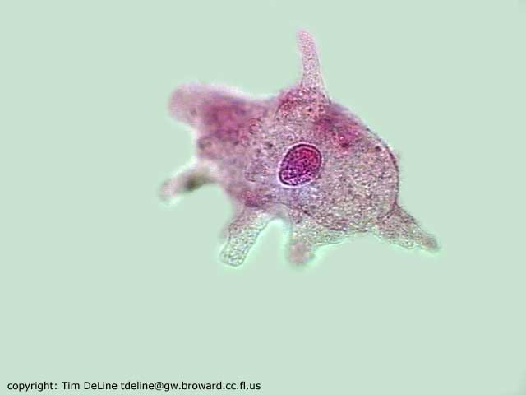
1. Amoeba
just visible to the naked eye
comes from the Greek word amoibe which means “change”
unicellular
moves by pseudopodia which give appearance of cell changing size and shape
aquatic - lives in ponds, ditches or slowly moving streams
can cause disease – amoebic dysentery,,,,,.
ingests small organisms like bacteria and other protozoans
Notes:
http://www.micrographia.com/specbiol/protis/homamoeb/amoe0100.htm
Amoeba movie # http://micro.magnet.fsu.edu/moviegallery/pondscum/protozoa/amoeba/index.html

Slide 10
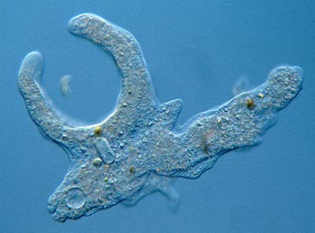
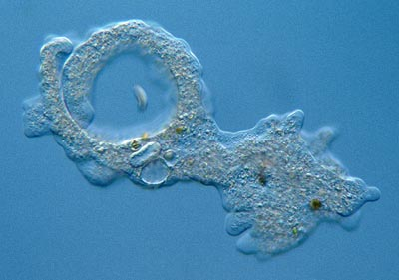
Amoeba
feeding sequence
psuedopodia surround and engulf food particle
process called phagocytosis

Slide 11
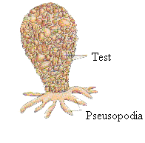
Lobosea contd:
Some members possess a test or shell
Tests are protective structures that the cytoplasm secretes. They may be made of calcium carbonate (calcareous), protein (proteinaceous), silica (siliceous) or chitin (chitinous)
One or more openings in the test allow pseudopodia to be extruded. Arcella and Difflugia are examples of freshwater shelled amoebae
Free-living amoebae are particle feeders, using their pseudopodia to capture food; a few are pathogenic
Entamoeba histolytica can infect human and live in the folds of the intestinal wall, feeding on starch and mucoid secretions causing dysentery in humans

Slide 12
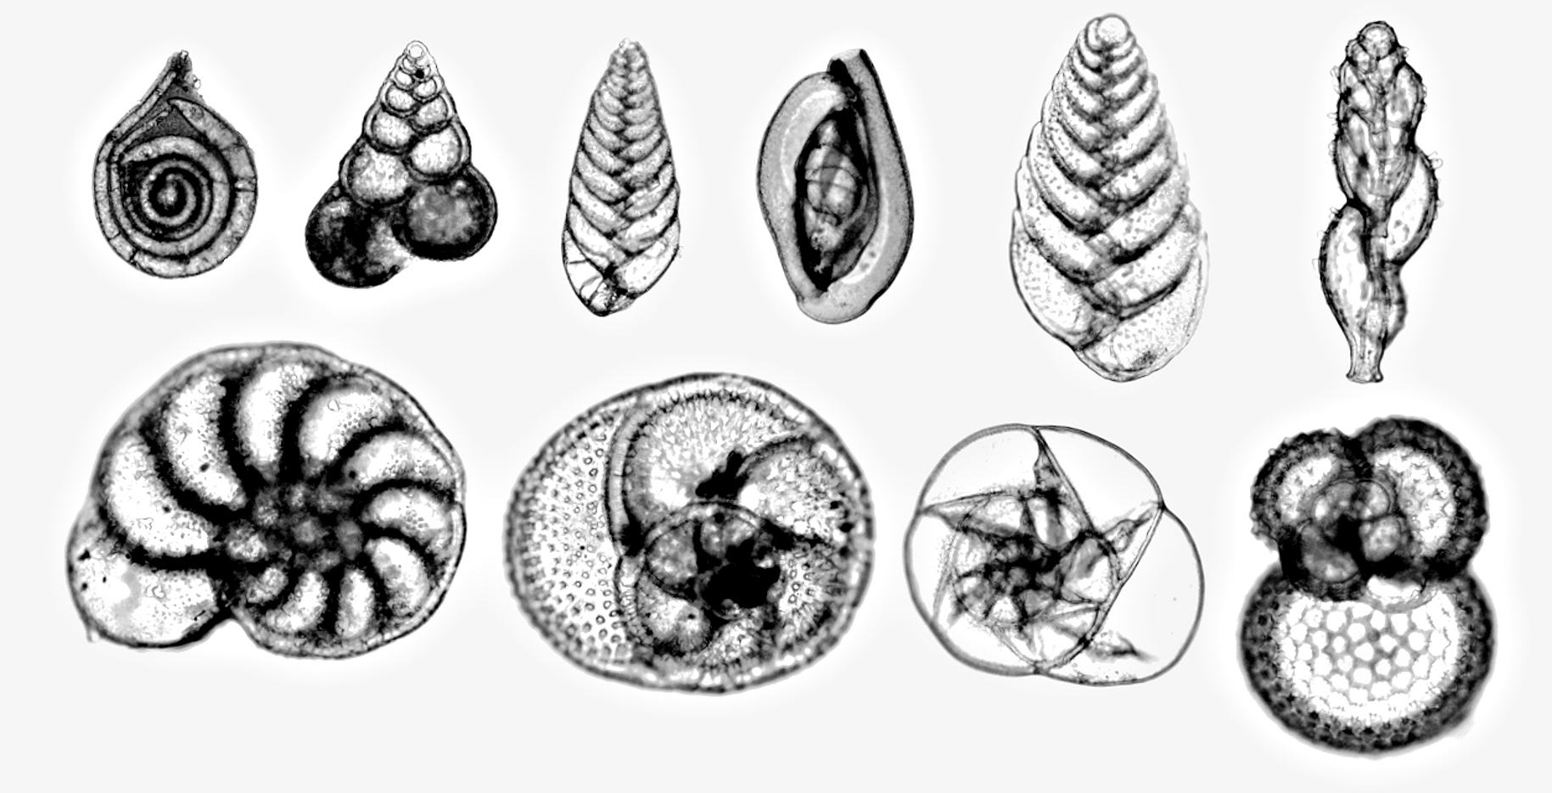
Foraminifera
Are primarily marine amoebas
They possess reticulopodia and secrete a test that is primarily calcium carbonate
As they grow, they secrete new, larger chambers that remain attached to the older chamber, making it look like snail shell
The foram tests make up a large component of marine sediments, and their accumulation on the floor of primeval oceans resulted in limestone and chalk deposits

Slide 13
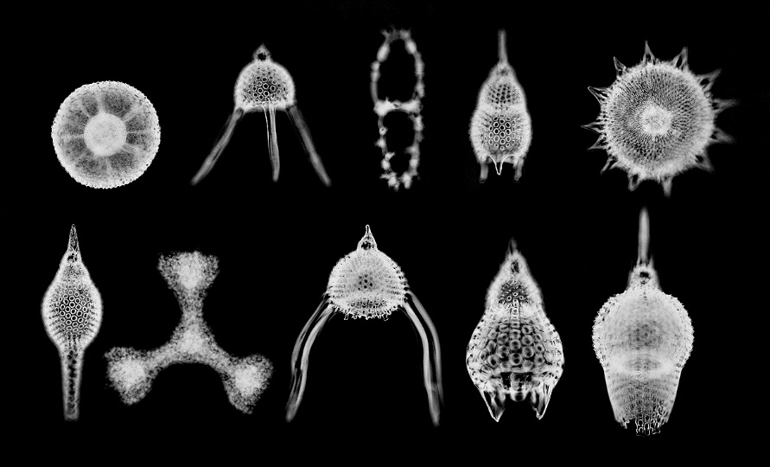
Radiolarians
Are planktonic marine and freshwater amoebae
They are relatively large; some colonial forms may reach several centimeters in diameter
They possess a test (usually siliceous) of long, movable spines and needles of a highly sculptured and ornamental lattice

Slide 14
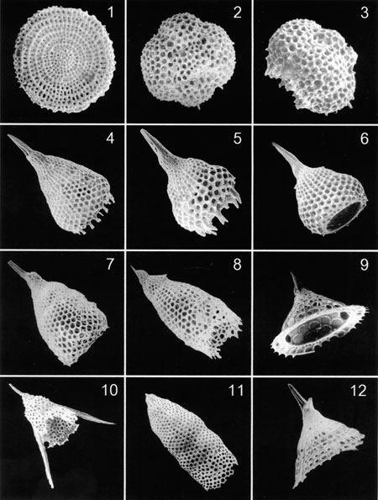

Slide 15
Heliozoans
They are aquatic amoebae that are either planktonic or live attached by a stalk to some substrate in both fresh water and marine environments
They are roughly spherical amoeboids with many stiff, microtubule-supported projections axopods radiating outward from the cell surface
They are similar to radiolaria, but they are distinguished from them by lacking central capsules and other complex skeletal elements, although some produce simple scales and spines.

Slide 16
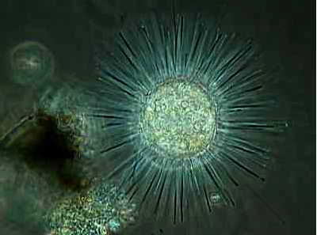

Slide 17


Slide 18
Thank You!

